Slide 1
Chicago Area Waterway System (CAWS) Chloride Reduction Initiative
Update Meeting
August 4, 2015
Tony Quintanilla, MWRD
Sanjay Sofat, IEPA
Jennifer Wasik, MWRD
Proceedings are being video recorded and will be made available at
chlorides.mwrd.org

Slide 2
Agenda
Introduction
Illinois Environmental Protection Agency presentation
Work Group discussion
Adjourn

Slide 3
Agenda
Introduction
Rulemaking
Variance process
Water quality data

Slide 4
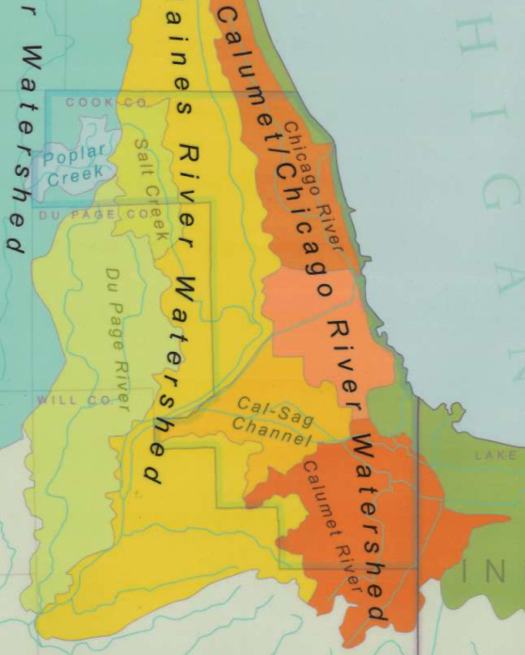
Chicago Area Waterway System (CAWS) Watersheds:
Chicago River
Calumet River
Cal-Sag Channel

Slide 5
Rulemaking
Use Attainability Analysis (UAA) Rulemaking – Docket R2008-09, Subdocked D.
Illinois Pollution Control Board (IPCB) has adopted final water quality standards for the CAWS and Lower Des Plaines watersheds, effective July 1, 2015.
Included are new standards for chlorides.

Slide 6
Rulemaking
Water Quality Standards (WQS), Section 302.407(g)(2, 3):
Effective 7/1/2015 – 7/1/2018:
Chloride WQS: 500 mg/L (5/1 – 11/30)
Effective 7/1/2018:
Chloride WQS: 500 mg/L (at all times)
Section 303.449:
The above does not apply to the Chicago Sanitary and Ship Canal.
Effective 7/1/2015:
Chronic Chloride WQS: 620 mg/L (12/1 – 4/30)
Acute Chloride WQS: 990 mg/L (12/1 – 4/30)

Slide 7
Rulemaking
CAWS do not meet the proposed winter chloride standard of 500 mg/L on a consistent basis.
Effluent limits based on the new standards will be difficult or impossible to meet.
The cost of technological controls for end-of-pipe solutions for water discharges would be enormous and impractical.
The IPCB has provided a delay in the implementation of the new rule to allow reduction in road salt use through July 1, 2018.

Slide 8
Rulemaking
IEPA has asked MWRD to convene and lead a work group to address the chloride issues during this 3-year period.
Goals:
Stakeholders will develop and implement Best Management Practices (BMPs) to address chloride issues.
Stakeholders will take action to develop and propose to the IPCB appropriate mechanisms to address compliance issues, including a water quality variance.

Slide 9
Variance Preparation
A variance is a temporary exemption from any specified rule, regulation, requirement or order of the Board…for a period of time not to exceed five years (Title 35, Part 104, Subpart B).
Extensions of the variance may be granted.
Variance is granted when the petitioner presents adequate proof that compliance with the rule would impose an arbitrary or unreasonable hardship.
The designated use in place is retained as the long-term goal when feasible progress can be made.
The variance provides a time-limited revision to the water quality standard that reflects the highest attainable condition.

Slide 10
Variance Preparation
By the deadline of July 21, 2015 MWRD requested IPCB to issue a variance and stay of the chloride standards that applies to all dischargers to ensure that dischargers are not unfairly penalized in the event that the work group process has not been completed by July 1, 2018.
In addition, since the CAWS flows into the Lower Des Plaines River, the petition included a request to extend the variance beyond to all dischargers to the Lower Des Plaines River.
This relief was requested on an interim basis until a permanent regulatory structure, such as a variance, is obtained.

Slide 11
Variance Preparation
The work group will pursue, if possible, a waterbody-specific variance or a multi-discharger variance.
Typically variances are adopted for individual dischargers.
The work group will work together to prepare the needed information for the petition.
Work group committees will be set up to coordinate the required information for the petition.
A legal committee will coordinate the preparation of the petition.
A best management practices (BMPs) committee will coordinate the needed solutions.

Slide 12
Variance Preparation
Development of best management practices (BMPs) is the primary goal of the work group.
The BMP program will be the basis for a legally and scientifically sound regulatory compliance structure for chlorides in the CAWS.
The regulatory compliance structure could take the form of a waterbody variance or individual variances for specific dischargers, up to a maximum of 5 years.
The goal will be to develop the BMP program, and create the regulatory structure and regulatory approval by July 1, 2018, then assess for effectiveness.

Slide 13
Variance Preparation
Implementation of BMPs that reduce the use of road salt during the winter:
BMPs should be watershed-specific to be effective.
There is often a significant lag between implementation of BMPs and significant water quality improvements.
Adaptive management is necessary.
It will take time for regulatory agencies and stake holders to review data, assess options, and to determine BMPs and an implementation schedule.

Slide 14
Variance Preparation
During the 3-year period through July 1, 2018, or longer if necessary, the work group will provide periodic reports to the IPCB on the status of the work group’s discussions.
At the end of the work group’s efforts, the work group will provide a final report to the IPCB, including recommendations and any proposed changes to regulations needed to implement the recommendations.
The cost of an effective BMP program has not been estimated.

Slide 15
Ambient Water Quality Monitoring Program
There are sixteen stations within the CAWS, covering the North Shore Channel, North Branch Chicago River, Chicago River, South Branch Chicago River, Bubbly Creek, Chicago Sanitary and Ship Canal, Cal-Sag Channel, Little Calumet River and Grand Calumet River.
Monthly sampling everywhere but Lockport on the Chicago Sanitary and Ship Canal, where it is weekly.
General chemistry, metals, organic chemicals; Chloride included.
Notes:
These programs are the tools we have on hand to help us assess historic baseline chloride conditions and future conditions after implementing BMPs.
Must recognize that even with all of our efforts, there may not be a concentration reduction evident from the water quality data. Many factors including flow conditions, weather conditions, etc.
But at least we have monitoring in place that should detect fluctuations and trends.

Slide 16
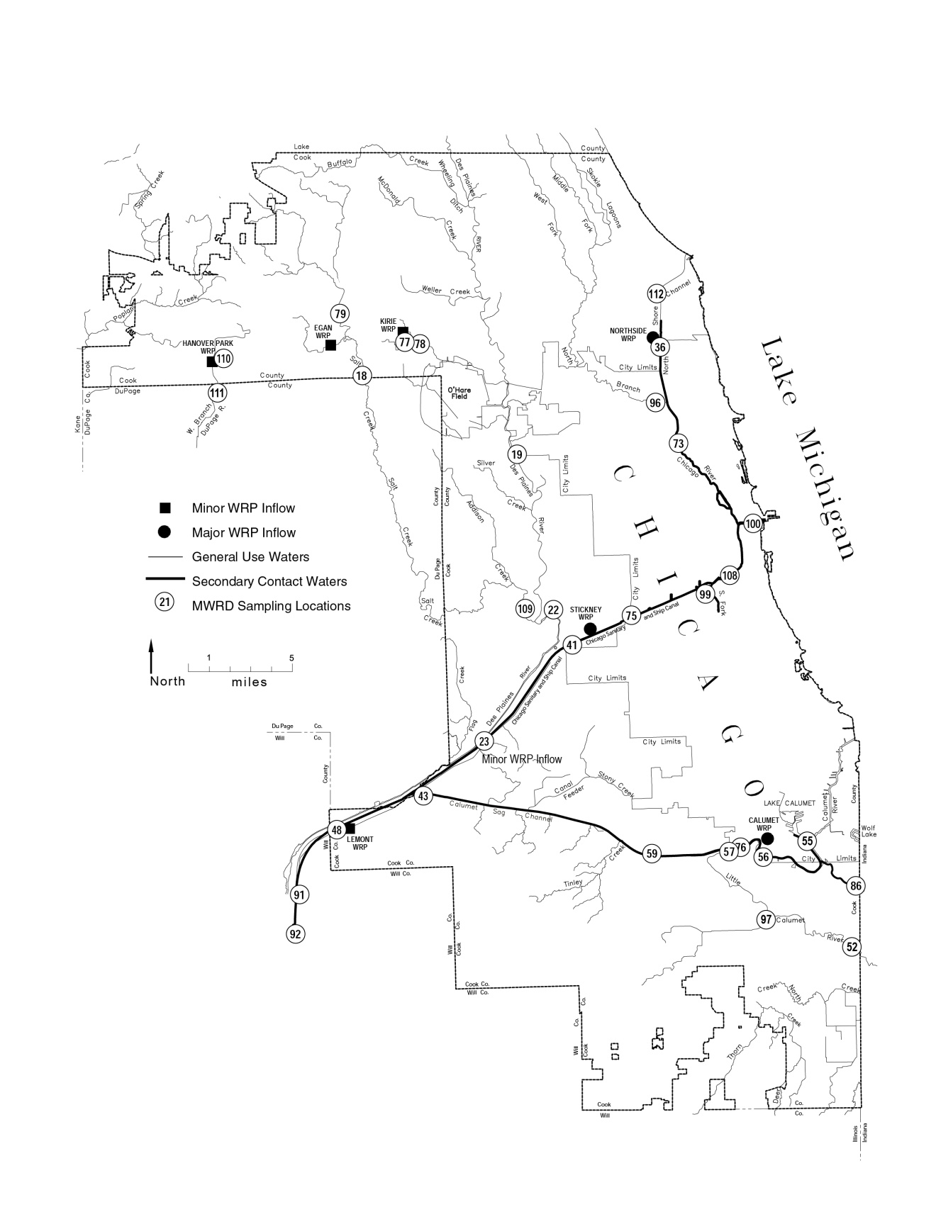

Slide 17
Summary of Chloride Exceedances of 500 mg/L during December - March, 2004 through 2013 in the Chicago Area Waterway System
Location | N Observations | N Excursions | % Excursions
Oakton Street, North Shore Channel | 32 | 0 | 0.0
Touhy Avenue, North Shore Channel | 39 | 7 | 17.9
Foster Avenue, North Shore Channel | 35 | 7 | 20.0
Wilson Avenue, North Branch Chicago River | 34 | 9 | 26.5
Diversey Parkway, North Branch Chicago River | 40 | 3 | 7.5
Grand Avenue, North Branch Chicago River | 34 | 5 | 14.7
Lake Shore Drive, Chicago River | 23 | 1 | 4.3
Wells Street, Chicago River | 38 | 1 | 2.6
Madison Street, South Branch Chicago River | 32 | 2 | 6.2
Loomis Street, South Branch Chicago River | 40 | 2 | 5.0
Archer Avenue, Bubbly Creek | 33 | 2 | 6.1
Damen Avenue, Chicago Sanitary & Ship Canal | 34 | 3 | 8.8
Cicero Avenue, Chicago Sanitary & Ship Canal | 40 | 2 | 5.0
Harlem Avenue, Chicago Sanitary & Ship Canal | 40 | 1 | 2.5
Route 83, Chicago Sanitary & Ship Canal | 32 | 3 | 9.4
Stephen Street, Chicago Sanitary & Ship Canal | 37 | 1 | 2.7
Lockport Forebay, Chicago Sanitary & Ship Canal | 163 | 17 | 10.4
Ewing Avenue, Calumet River | 18 | 0 | 0.0
130th Street, Calumet River | 19 | 0 | 0.0
Burnham Avenue, Grand Calumet River | 18 | 0 | 0.0
Indiana Avenue, Little Calumet River | 19 | 0 | 0.0
Halsted Street, Little Calumet River | 33 | 1 | 3.0
Ashland Avenue, Calumet Sag Channel | 30 | 2 | 6.7
Cicero Avenue, Calumet Sag Channel | 31 | 1 | 3.2
Route 83, Calumet Sag Channel | 27 | 1 | 3.7
Notes:
Note this is compared to 500 mg/L but the IPCB final rulemaking deemed 990 site specific for winter months on the CSSC only. If you compare our data to 990, then there would have been no exceedances at any CSSC station except Harlem where there was 1.

Slide 18
Continuous Water Quality Monitoring
There are twelve stations within the CAWS, covering the North Shore Channel, North Branch Chicago River, Chicago River, South Branch Chicago River, Bubbly Creek, Chicago Sanitary and Ship Canal, Cal-Sag Channel, and Little Calumet River.
Hourly conductivity, dissolved oxygen, and temperature readings.
Develop linear regression models relating hourly conductivity to chloride concentrations analyzed in the AWQM program.
Potential to use hourly conductivity to estimate chloride levels so snow melt and winter salt application effects can be captured.
Similar procedure used by DuPage River Salt Creek Workgroup on system-wide basis
Enough data to use site specific models?
Notes:
Linear regression model showed very good fit. r2=>94% 2007-2013 at Lockport.

Slide 19
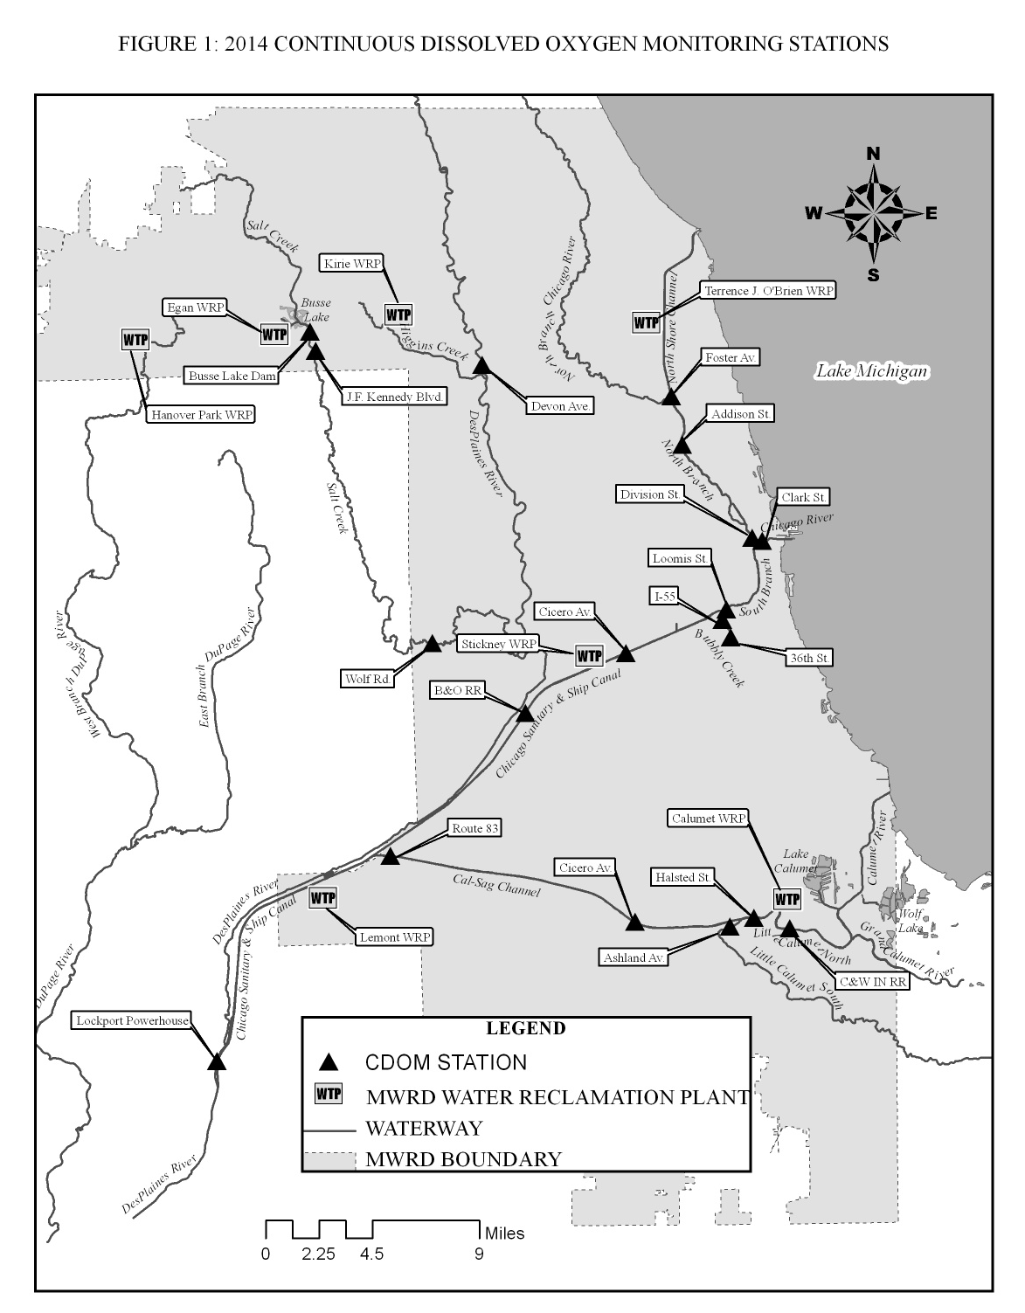

Slide 21
Agenda
Illinois Environmental Protection Agency presentation
Current ambient conditions
Alternatives and Best Management Practices
Description of facility operations
Description of the environmental impacts
Description of Social and economic impacts
Reporting and documentation requirements
Relief requested

Slide 22
Agenda
Work Group discussion
Legal
Data acquisition
Best Management Practices
Water Quality
Social and Economic Impact

Slide 23
Work Group
Data Acquisition Committee:
Coordinates data acquisition.
Acquires winter water quality data.
MWRD, IEPA, USGS, discharger data.
Each entity must ensure they have sufficient data.
Coordinates description of facility operations for each entity seeking a variance.
Description of nature and amount of chlorides used.
Description of chloride controls and BMPs in use (survey).

Slide 24
Survey
Please complete the distributed survey (chlorides.mwrd.org) indicating:
Contact information.
Interest of your organization in participating in this stakeholder work group.
Interest in participating in the committees.
Interest in attending or presenting at future training workshops.
Salt use information.

Slide 25
Work Group
Water Quality Committee:
Analysis of water quality data.
Demonstrate that compliance cannot be immediately reached in the receiving stream and discharges.
Discussion of the compliance plan: BMPs to be undertaken; a schedule; and estimated costs.
Discussion of the environmental impact of the compliance plan, and measures to minimize the impact.
Discussion of interim numerical discharge limitations.
Develop a monitoring plan for each watershed.
Annual report documenting progress in each watershed.

Slide 26
Work Group
Best Management Practices Committee:
Discussion of alternatives and BMPs based on a literature search.
Discussion of alternatives and BMPs necessary to achieve compliance with the water quality standard.
Discussion of availability and selection of BMPs.
Discussion explaining why immediate compliance would cause an unreasonable hardship.
Documentation must be provided to the IPCB.
Annual report on implementation of cost-effective and reasonable BMPs must be provided to the IPCB.
BMP Training Workshops.

Slide 27
BMP Training Workshops
Begin workshops in the Fall of 2015:
BMPs for deicing of:
Roads
Parking lots and sidewalks
Presenters from the Chicago area and national experts.
Best methods, equipment and products for winter de-icing.
Equipment demonstrations.

Slide 28
Work Group
Social and Economic Impact Committee:
Social impact analysis.
Economic impact analysis.
Documentation.

Slide 29
Work Group
Legal Committee:
Determine variance conditions.
Type of variance.
Time frame.
Terms.
Effective date.
Prepare the petition, using information from committees.
Filing of petition.
Annual report to the IPCB describing steps taken to meet the requirements of the variance, using information from committees.

Slide 30
Next Steps
Stakeholders are requested to complete their surveys.
Stakeholders are requested to sign-up to participate in one or more committees.
Committees will convene to start working on their charges and timelines.
Best management practices committee will start working on the Fall Workshop.

Slide 31
Q/A Thank you!
Tony Quintanilla, MWRD:
antonio.quintanilla@mwrd.org
(312) 751-5102
Sanjay Sofat, IEPA:
sanjay.sofat@illinois.gov
(217) 782-3397
Proceedings are being video recorded and will be made available at chlorides.mwrd.org

