Slide 1
Chicago Area Waterway System (CAWS) Chloride Reduction Initiative
2015
Tony Quintanilla, MWRD
Adam Gronski, MWRD

Slide 2
Agenda
Introduction.
Presentation of chloride issue.
Purpose of CAWS chloride reduction initiative.
Role of stakeholders.

Slide 3
Rulemaking Overview
Use Attainability Analysis (UAA) Rulemaking – Docket #R08-09
Illinois Pollution Control Board (IPCB) will issue new water quality standards for the CAWS including proposed chloride standards.
CAWS do not meet the proposed chloride standard of 500 mg/L.
Final rule expected by the end of 2015.

Slide 4
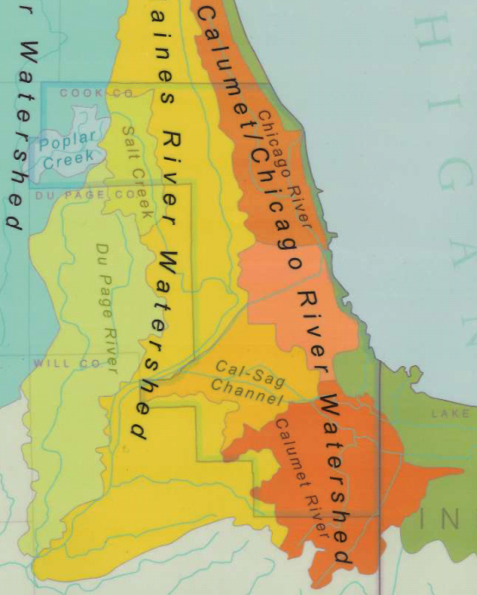
Chicago Area Waterway System (CAWS) Watersheds:
Chicago River
Calumet River
Cal-Sag Channel

Slide 5
Chloride Issue
Need a stakeholder work group to develop best management practices (BMPs) to reduce chlorides discharging to the CAWs.
Need the work group to develop a variance petition (waterbody specific) to be presented to the IPCB
A variance from the standard would allow time for BMPs to be developed and implemented and to monitor improvements.

Slide 6
Overview of the CAWS Chloride Reduction Initiative
Create a stakeholder work group to:
Promote and train on best management practices.
Prepare and submit the variance petition.
Monitor progress and compile data.
Stakeholder work group to be led by a Steering Committee.

Slide 7
Stakeholders and Their Role
Municipalities, Industry, State Agencies, Cook County, City of Chicago, Non-Governmental Organizations, and MWRD
Develop BMPs for salt use reduction.
Implement BMPs to use salt efficiently for de-icing.
Learn and train on best methods, including workshops.
Document salt use reduction.
Participate in the variance petition process.
Contribute to the cost of preparing the variance petition.
Provide salt use information requested by the work group.

Slide 8
Work Group Membership
Voluntary participation and led by a Steering Committee
Members are expected to:
Practice existing BMPs to use salt efficiently for de-icing.
Share knowledge of BMPs best methods for salt use reduction.
Develop and participate in BMP training workshops led by stakeholders.
Document salt use reduction and share data.
Contribute to the cost of preparing the variance petition by retaining legal counsel for the Work Group.

Slide 9
Steering Committee
Will lead on organizing training workshops for the work group.
Will lead on coordinating variance petition preparation for the work group.
Proposed:
Ad-Hoc members
City of Chicago
Cook County
Councils of Government (four)
Illinois Department of Transportation
Industrial Sector
Illinois Tollway Authority
MWRD

Slide 10
BMP Training Workshops
Begin workshops in the Summer to Fall of 2015:
BMPs for deicing of:
Roads
Parking lots and sidewalks
Presenters from the Chicago area.
Best methods, equipment and products for winter de-icing.
Equipment demonstrations.

Slide 11
Variance Petition Overview
A variance is a temporary exemption from any specified rule, regulation, requirement or order of the Board…for a period of time not to exceed five years (Title 35, Part 104, Subpart B).
Extensions of the variance may be granted.
Variance is granted when the petitioner presents adequate proof that compliance with the rule would impose an arbitrary or unreasonable hardship.

Slide 12
Variance Preparation
Steering Committee will hire legal counsel on behalf of the work group.
Members will contribute equally towards legal fees.
Fees to be determined.
Legal counsel will work through the Steering Committee to request member information for the preparation of the variance petition.
Steering Committee will coordinate with Work Group members to provide information in support of the petition for variance.
Legal counsel will submit variance petition to IPCB.

Slide 13
Survey
Please complete survey found on our website: www.mwrd.org/irj/portal/anonymous/CAWSChloride
Contact information.
Interest of your organization in participating in this stakeholder work group.
Interest in participating in the Steering Committee or sub-committees.
Interest in attending or presenting at future training workshops.
Salt use information.
Please complete and return the survey as soon as possible.
Address information is on the survey form.

Slide 14
Next Steps
Steering Committee will:
Compile initial survey information.
Initiate process to hire legal counsel for preparation of variance petition.
Provide updates to the membership.
Schedule membership meetings.

Slide 15
Q/A Thank you!
Contact information:
Tony Quintanilla, MWRD:
antonio.quintanilla@mwrd.org
(312) 751-5102
Sanjay Sofat, IEPA:
sanjay.sofat@illinois.gov
(217) 782-3397

